Slide 1

Multithreaded Programming for Mere Mortals
Emery Berger University of Massachusetts, Amherst

Slide 2
In the Beginning…
Notes:
In the beginning, there was the Core. And it was good.

Slide 3
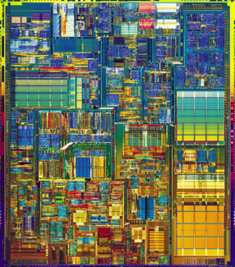
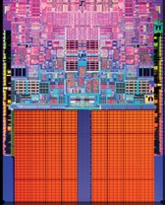
There was the Core.

Slide 4
And it was Good.

Slide 5
It was Very Good. Until…

Slide 6
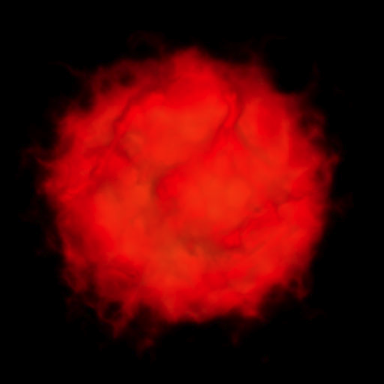
…the Apocalypse.

Slide 7
And the Speed was no Moore.

Slide 8
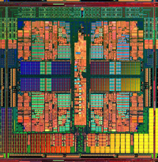

More is Moore (?)…
“
”

Slide 12
color = ; row = 0; // globals
void nextStripe(){
for (c = 0; c < Width; c++) {
drawBox (c,row,color);
}
color = (color == )?  : ; row++;
}
for (n = 0; n < 9; n++) {
spawn nextStripe();
}
sync;

Slide 16
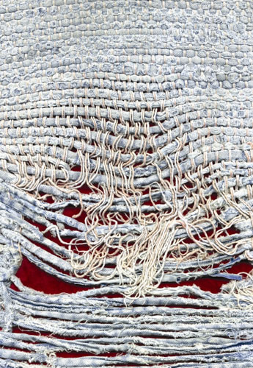
Notes:
Too few threads

Slide 17
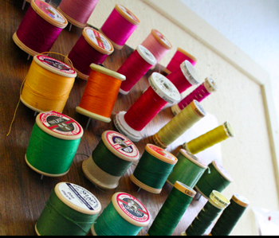
Notes:
Too many threads

Slide 18


( )
Notes:
contention

Slide 19

Notes:
One big lock

Slide 20
Notes:
Fine-grained locks (lock acquisition overhead)

Slide 21

False Sharing!
Notes:
Insidious!

Slide 22
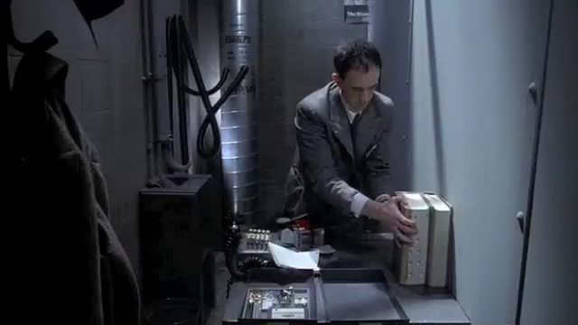
Notes:
(Brazil – didn’t know the desk was shared!)

Slide 23

mine!
yours!
cache line

Slide 24
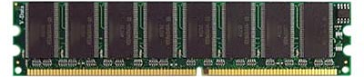
Thread 1
Thread 2
Invalidate
Notes:
Cache coherence protocol makes false sharing problem unpleasant performance effect

Slide 25
Thread 1
Thread 2
Invalidate
20x slower!

Slide 26
me = 1;
you = 1; // globals
me = new Foo;
you = new Bar; // heap
class X {
int me;
int you;
}; // fields
arr[me] = 12;
arr[you] = 13; // array indices

Slide 27
me = 1;
you = 1; // globals
me = new Foo;
you = new Bar; // heap
class X {
int me;
int you;
}; // fields
arr[me] = 12;
arr[you] = 13; // array indices

Slide 28
me = 1;
you = 1; // globals
me = new Foo;
you = new Bar; // heap
class X {
int me;
int you;
}; // fields
arr[me] = 12;
arr[you] = 13; // array indices

Slide 29
me = 1;
you = 1; // globals
me = new Foo;
you = new Bar; // heap
class X {
int me;
int you;
}; // fields
arr[me] = 12;
arr[you] = 13; // array indices

Slide 30
me = 1;
you = 1; // globals
me = new Foo;
you = new Bar; // heap
class X {
int me;
int you;
}; // fields
arr[me] = 12;
arr[you] = 13; // array indices

Slide 31

+ 850 lines…

Slide 32

No false positives
Sheriff-Detect
Object has 13767 interleaving writes
(starts at 0xd5c8e160, length 32).
Allocation call stack:
0: wordcount.c: 136
1: wordcount.c: 444
(“share-if”)
Precise object identification

Slide 33


Slide 34
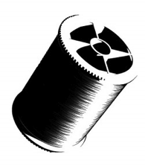
t1 = spawn f(x);
t2 = spawn g(y);
sync;

Slide 35

t1 = spawn f(x);
t2 = spawn g(y);
sync;
if (!fork())
f(x);
if (!fork())
g(y);
Grace [OOPSLA 2009]

Slide 36
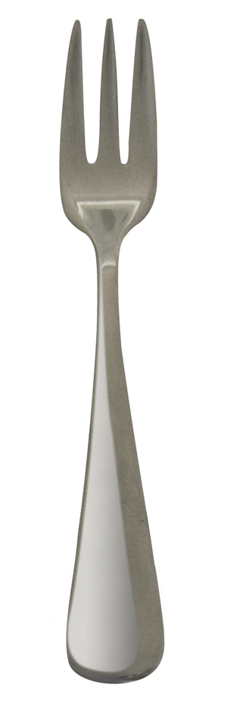
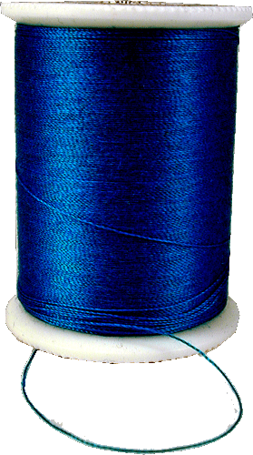
Isolation
shared address space
disjoint address spaces
Notes:
Obviously this doesn’t preserve shared memory semantics, so we need to commit changes made by one thread so they become visible to others.

Slide 37
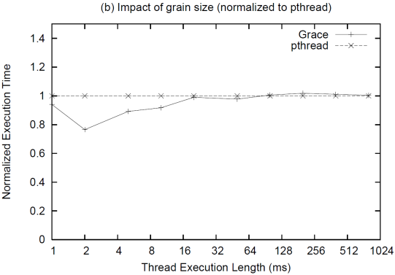
Performance: Processes vs. Threads
1.4
1.2
1.0
0.8
0.6
0.4
0.2
0.0
threads
processes
Normalized Execution Time
1 2 4 8 16 32 64 128 256 512 1024
Thread Execution Time (ms)
Notes:
ADD ANIMATIONS: threads initially on one core then migrating, vs. processes spewed across cores

Slide 38
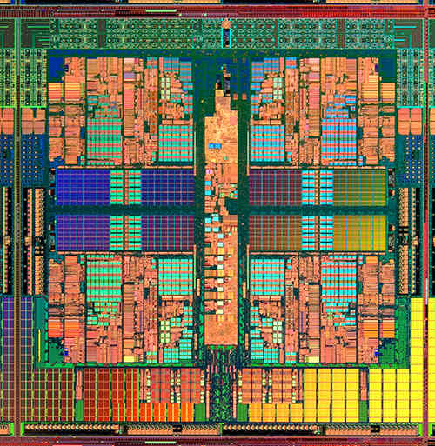
Performance: Processes vs. Threads
1.4
1.2
1.0
0.8
0.6
0.4
0.2
0.0
threads
processes
Normalized Execution Time
1 2 4 8 16 32 64 128 256 512 1024
Thread Execution Time (ms)
Notes:
ADD ANIMATIONS: threads initially on one core then migrating, vs. processes spewed across cores

Slide 39
Performance: Processes vs. Threads
1.4
1.2
1.0
0.8
0.6
0.4
0.2
0.0
threads
processes
Normalized Execution Time
1 2 4 8 16 32 64 128 256 512 1024
Thread Execution Time (ms)
Notes:
ADD ANIMATIONS: threads initially on one core then migrating, vs. processes spewed across cores

Slide 40

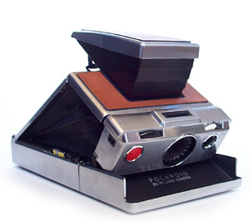
“Shared Memory”

Slide 41
“Shared Memory”
Snapshot pages before modifications

Slide 42

Write back diffs
“Shared Memory”
Snapshot pages before modifications

Slide 43
X
Y
for (i = 0; i < M; i++)
{
x = 1;
}
for (i = 0; i < M; i++)
{
y = 2;
}

Slide 44
X
Y
0
0
0
0
for (i = 0; i < M; i++)
{
x = 1;
}
for (i = 0; i < M; i++)
{
y = 2;
}

Slide 45
X
Y
0
0
0
0
1
0
for (i = 0; i < M; i++)
{
x = 1;
}
for (i = 0; i < M; i++)
{
y = 2;
}

Slide 46
X
Y
0
0
0
0
1
0
0
2
for (i = 0; i < M; i++)
{
x = 1;
}
for (i = 0; i < M; i++)
{
y = 2;
}

Slide 47
X
Y
0
0
0
0
1
0
0
2

Slide 48
X
Y
0
0
0
0
1
0
0
2
1
0

Slide 49
X
Y
0
0
0
0
1
0
0
2
1
0

Slide 50
X
Y
0
0
0
0
1
0
0
2
1
2

Slide 51
X
Y
0
0
0
0
1
0
0
2
1
2

Slide 52
Output: PTU vs. Sheriff-Detect
Benchmarks | PTU (# shared lines) | SHERIFF-DETECT (# shared objects)
canneal | 1 | 1
fluidanimate | 3 | 1
kmeans | 1916 | 2
linear_regression | 5 | 1
matrix_multiply | 468 | 0
pbzip2 | 14 | 0
pca | 45 | 0
pfscan | 3 | 0
reverse_index | N/A | 0
streamcluster | 9 | 1
word_count | 4 | 4
swaptions | 196 | 0
TOTAL | 2,664 | 15
kmeans 1916 2
reverse_index N/A 5
Total 2,664 15
Notes:
Joke: I haven’t verified every reports of PTU. Because the output of PTU is non actionable and there are many false positives, I will have to spend a lot of time to figure out one problem.
If I have to figure out all of these problems, I will never graduate.
Allocation sites/cache lines, we intercept memory allocation/free operations.
Example: one allocation site, called 100 times. PTU can at least report 100 cache lines, but sheriff-detect only report once since they are from the same allocation sites.
They can’t distinguish false sharing and true sharing.
They can overstate the occurs of false sharing problem since they don’t take interleaved memory access into account.
PTU can’t differentiate true sharing and false sharing,
They can’t tell when heap object is re-used.
They will report some cases when memory access are not interleaved.
In total,

Slide 53
typedef struct {
long long SX;
long long SY;
long long SXX;
…
} lreg_args;
void *linear_regression_pthread (void *args_in)
{
lreg_args* args =(lreg_args*)args_in;
……
for (i = 0; i < args->num_elems; i++)
{
args->SX += args->points[i].x;
args->SXX += args->points[i].x*args->points[i].x;
……

Slide 54
/home/emery/sheriff$

Slide 55
/home/emery/sheriff$ gcc lreg.c -lsheriff_detect -o lreg

Slide 56
/home/emery/sheriff$ gcc lreg.c -lsheriff_detect -o lreg
/home/emery/sheriff$

Slide 57
/home/emery/sheriff$ gcc lreg.c -lsheriff_detect -o lreg
/home/emery/sheriff$ ./lreg

Slide 58
/home/emery/sheriff$ gcc lreg.c -lsheriff_detect -o lreg
/home/emery/sheriff$ ./lreg
...
Sheriff-Detect has detected false sharing.
Object 1: Allocation call stack:
0: lreg.c: line number: 136

Slide 59
/home/emery/sheriff$ gcc lreg.c -lsheriff_detect -o lreg
/home/emery/sheriff$ ./lreg
...
Sheriff-Detect has detected false sharing.
Object 1: Allocation call stack:
0: lreg.c: line number: 136
(1) Examine allocation site

Slide 60
/home/emery/sheriff$ gcc lreg.c -lsheriff_detect -o lreg
/home/emery/sheriff$ ./lreg
...
Sheriff-Detect has detected false sharing.
Object 1: Allocation call stack:
0: lreg.c: line number: 136
(1) Examine allocation site
136 tid_args = (lreg_args *)calloc(sizeof(lreg_args), num_procs);
(2) Find references
152 pthread_create(&tid_args[i].tid, &attr, linear_regression_pthread, (void*)&tid_args[i]) != 0);

Slide 61
void *linear_regression_pthread(void *args_in)
{
lreg_args* args =(lreg_args*)args_in;
……
for (i = 0; i < args->num_elems; i++)
{
args->SX += args->points[i].x;
args->SXX += args->points[i].x*args->points[i].x;
……
“lreg_args” is not cache-line aligned

Slide 62
(3) Fix false sharing (here: padding)
typedef struct {
…..
char padding[128]; // Padding to avoid false sharing
} lreg_args;
9.2X
Notes:
However, not all padding can improve the performance. It may hurt the performance due to the loss of locality.

Slide 63
Sheriff-Detect performance
8.2
11.4
20%
?
Notes:
X axis: Two benchmark suite(Phoenix) and PARSEC, two real applications
Y axis: Normalized runtime to pthreads. Pthreads result will be always 1. Smaller is better.
Most of benchmarks, performance are close to pthreads
Only two of them introduce high overhead
For some: significant better than pthreads even with detection.
What is happening here? If we can eliminate the false sharing, then it is natural to avoid false sharing problem.
Also, if we don’t have source code or no time to do this,
we can use sheriff-detect to improve the performance automatically.

Slide 64


Slide 65

Sheriff-Protect
Prevents all false sharing

Slide 66


=
-
Sheriff-Protect
Sheriff-Detect

Slide 67
X
Y
0
0
0
0
1
0
0
2
for (i = 0; i < M; i++)
{
x = 1;
}
for (i = 0; i < M; i++)
{
y = 2;
}

Slide 68
8.2
11.4
13%
Notes:
Phonix and PARSEC (17), 2 real application
Normalized run time
13% improvement , 10X, other performance improvement
Linear_regression: one heap object, different threads on different entry.
5. Performance better if only on false sharing objects.
6.
Fluidanimate: too much transactions, kmeans: forking overhead. reverse_index: thread-vs-process

Slide 69
false sharing detection
original program
Sheriff-Detect
Sheriff-Detect

Slide 70

false sharing detection
Use Sheriff-Detect reports to guide modifications (padding, alignment)
original program
modified program
Sheriff-Detect
libpthread
False Sharing!
Sheriff-Detect

Slide 71
false sharing detection
Use Sheriff-Detect reports to guide modifications (padding, alignment)
original program
modified program
Sheriff-Detect
libpthread
False Sharing!
Sheriff-Detect
no false sharing
original program
libpthread

Slide 72
false sharing detection
Use Sheriff-Detect reports to guide modifications (padding, alignment)
original program
modified program
Sheriff-Detect
libpthread
False Sharing!
Sheriff-Detect
source code unavailable or insufficient resources to act on Sheriff-Detect reports
no false sharing
modifications degrade performance or cause excess memory consumption
original program
original program
libpthread
Sheriff-Protect
false sharing mitigation
Sheriff-Protect

Slide 73


Slide 74


Slide 75


Slide 76


Slide 77
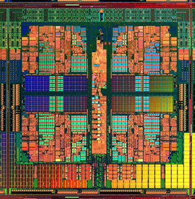
Dthreads
% g++ myprog.cpp –ldthreads –o myprog

Slide 78
race conditions
Dthreads
atomicity violations
deadlock
order violations

Slide 79

race conditions
Dthreads
atomicity violations
deadlock
order violations
deterministic

Slide 80



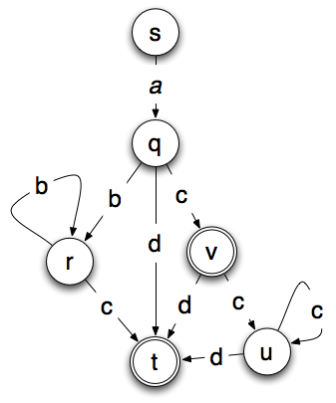
Dthreads = Deterministic Execution =
Race-free Executions
Replay Debugging w/o Logging
Replicated State Machines

Slide 81
Debuggable Races

Slide 82
Debuggable Races

Slide 83
Debuggable Races

Slide 84
Debuggable Races

Slide 85

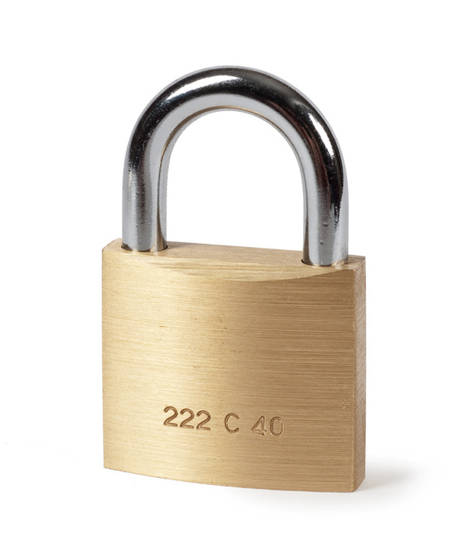
Update in Deterministic Time & Order
Parallel
Serial
Parallel
mutex_lock
“Thread” 1
cond_wait
“Thread” 2
pthread_create
“Thread” 3

Slide 86
Dthreads: Efficient Determinism
7.8
Usually faster than the state of the art
Notes:
Highlight when same speed or faster.

Slide 87
Dthreads: Efficient Determinism
7.8
Generally as fast
or faster than pthreads
Notes:
Highlight when same speed or faster.

Slide 88
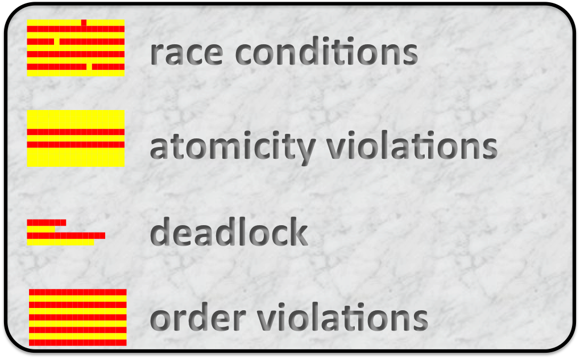

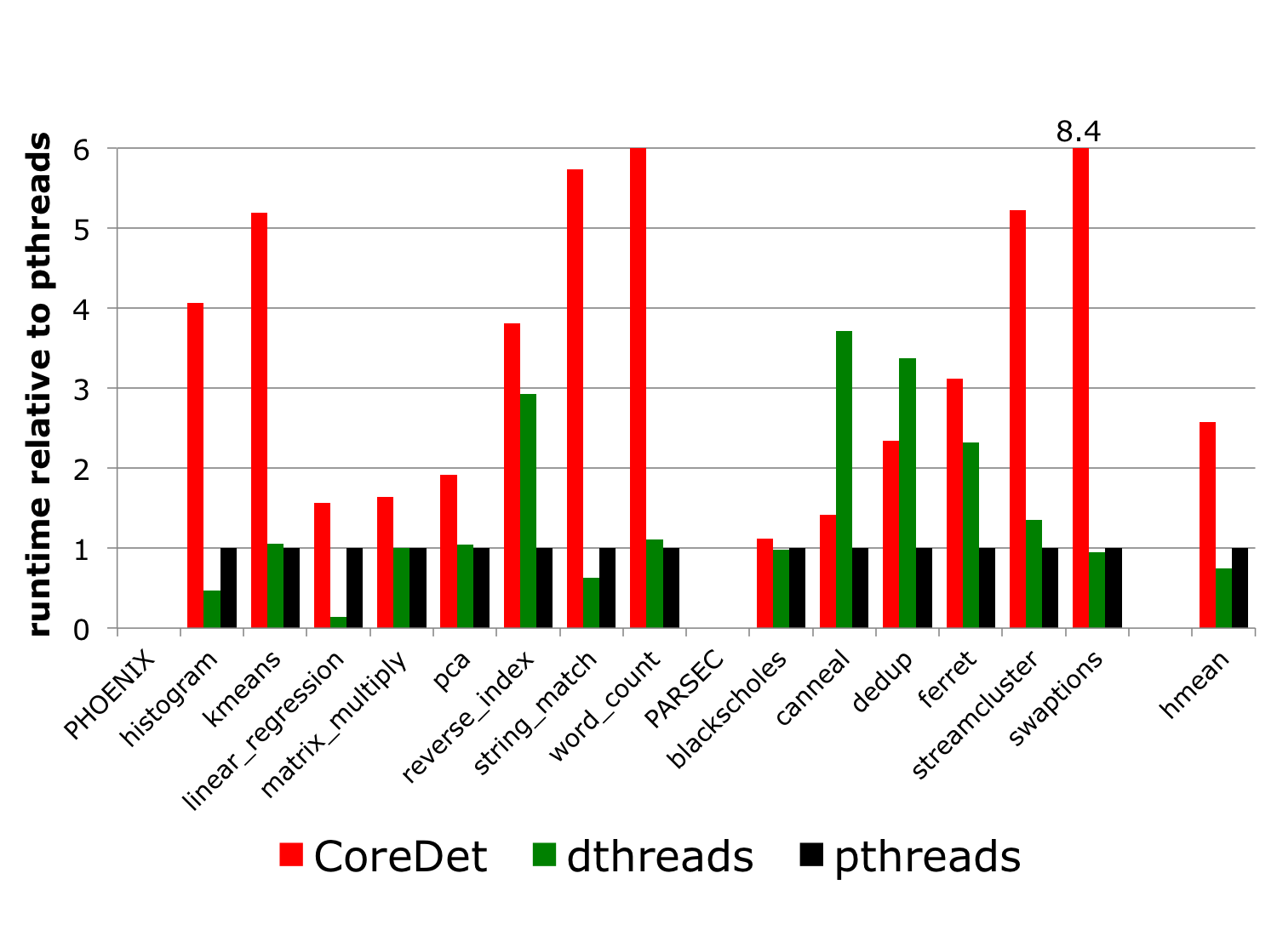
Dthreads
% g++ myprog.cpp –l thread
p
Notes:
Panel 1 = what it does, panel 2 = how, panel 3 = efficient, panel 4 = easy to use

Slide 89
Sheriff-Detect
Sheriff-Protect

Slide 90

Sheriff-Detect
Sheriff-Protect
[OOPSLA 2011]

Slide 91
Sheriff-Detect
Sheriff-Protect
Dthreads
[OOPSLA 2011]

Slide 92

Sheriff-Detect
Sheriff-Protect
Dthreads
[OOPSLA 2011]
[SOSP 2011]

Slide 93
https://github.com/plasma-umass/sheriff
https://github.com/plasma-umass/dthreads

